Slide 1
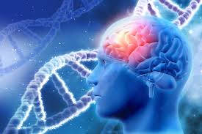
Deep learning model in analysing the Genetic variation associated with the occurrence and progression of Neurodevelopmental disorder
Project Proposal

Slide 2
Team Members
Computer Science | Biotechnology
Dr. S. Pitchumani Angayarkanni Associate Professor, Department of Computer Science Lady Doak College | Dr. S. Kalaivani Priyadarshini, Assistant Professor, Department of Biotechnology, Lady Doak College
Dr. Sofia, Associate Professor, Department of Computer Science, Lady Doak College. | Ms. Raga Priya UG Student Bioinformatics TN Agricultural university. Coimbatore

Slide 3
Review of Literature
Papers | Focus | Outcome
Tărlungeanu, D.C., Novarino, G. Genomics in neurodevelopmental disorders: an avenue to personalized medicine. Exp Mol Med 50, 100 (2018). https://doi.org/10.1038/s12276-018-0129-7 | autism spectrum disorders (ASD), intellectual disability (ID) and language disorders | On average, a newborn acquires between 50 and 100 new genetic variants, resulting in 0.86 new amino acid-altering mutations (i.e., de novo mutations) per individual Common inherited genetic variants contribute substantially to ASD risk (49%); however, the individual common genetic variant liability is lower than that for rare genetic mutations
Uddin, M., Wang, Y. & Woodbury-Smith, M. Artificial intelligence for precision medicine in neurodevelopmental disorders. npj Digit. Med. 2, 112 (2019). https://doi.org/10.1038/s41746-019-0191-0 | NDDs are severe disorders that impact multiple domains of cognitive functioning, such as intellectual disability (ID), as well as severe and pervasive disorders of social communication (autism spectrum disorder, ASD), motor function and cognition (epilepsy encephalopathies), and behavioral regulation (attention deficit hyperactivity disorder, ADHD). | NDDs, particularly single gene disorders with more severe cognitive and medical consequences, are very rare. ASD and ADHD in particular are now relatively common, and result in major functional impairment, in part related to the high rates of co-morbidity. Epilepsy is one such comorbidity, with 20% of people with ASD also receiving this diagnosis. Moreover, epilepsy itself is often neurodevelopmental, although can sometimes occur de novo in adulthood or later in life.

Slide 4
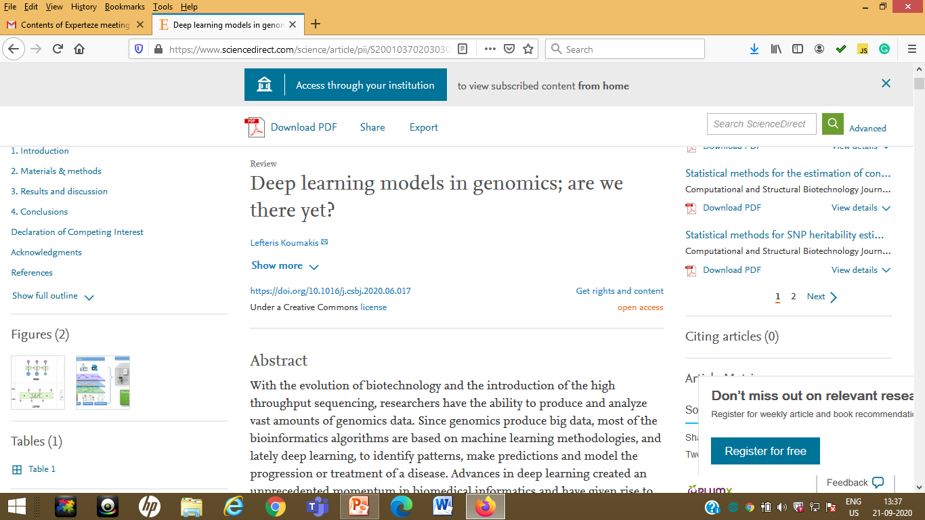
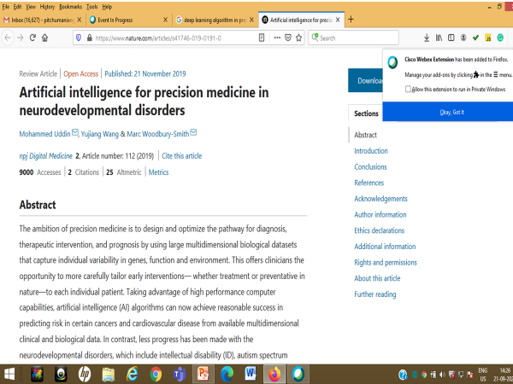

Slide 5
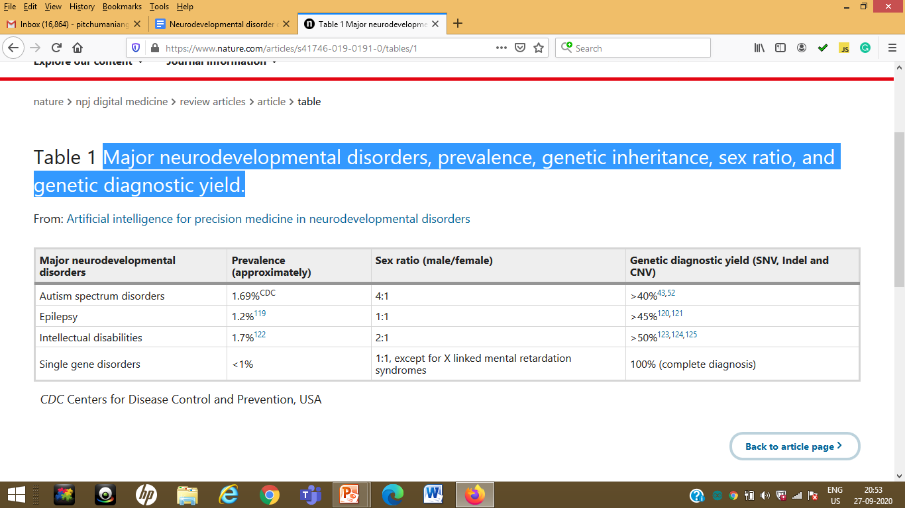
Major Neurodevelopmental Disorder

Slide 6
Gene Variation Study
Autism
https://ghr.nlm.nih.gov/search?query=autism&tab=gene
ADHD
https://ghr.nlm.nih.gov/search?query=adhd&tab=gene
Duchenne muscular dystrophy
https://ghr.nlm.nih.gov/search?query=duchenne+muscular+dystrophy&tab=gene&rows=10
cerebral palsy
https://ghr.nlm.nih.gov/search?query=cerebral+palsy&tab=gene

Slide 7
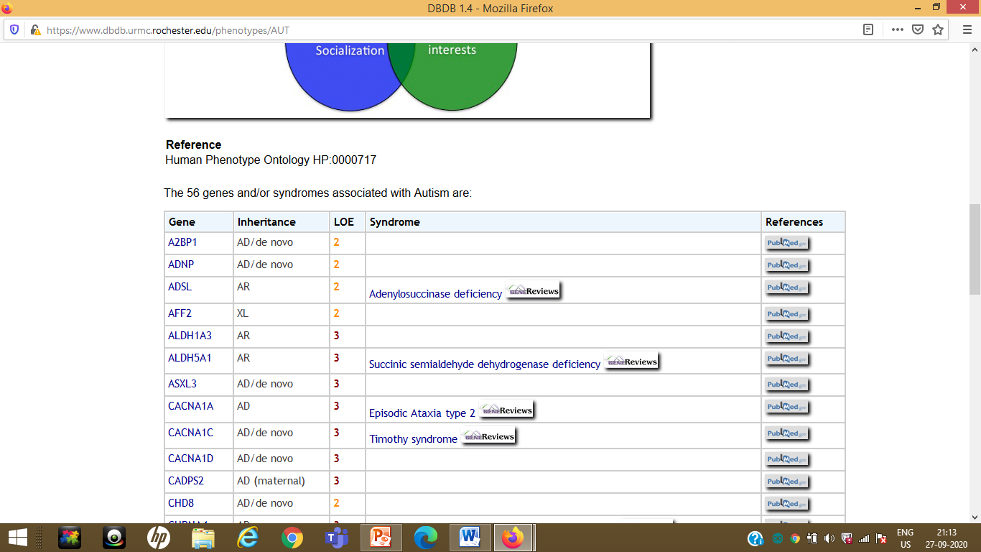

Slide 8
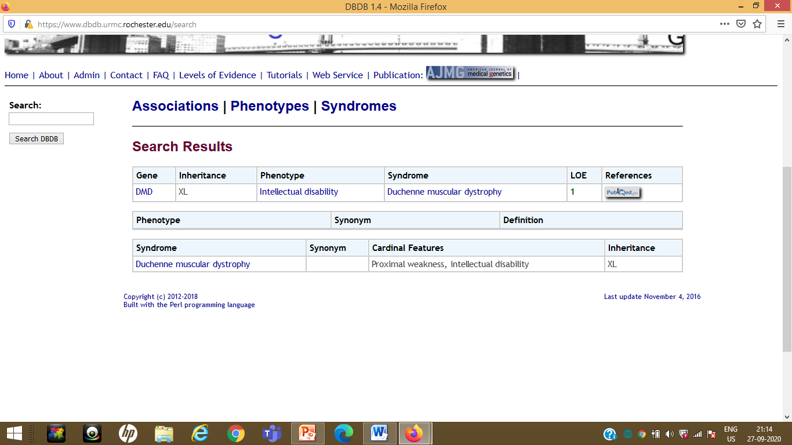
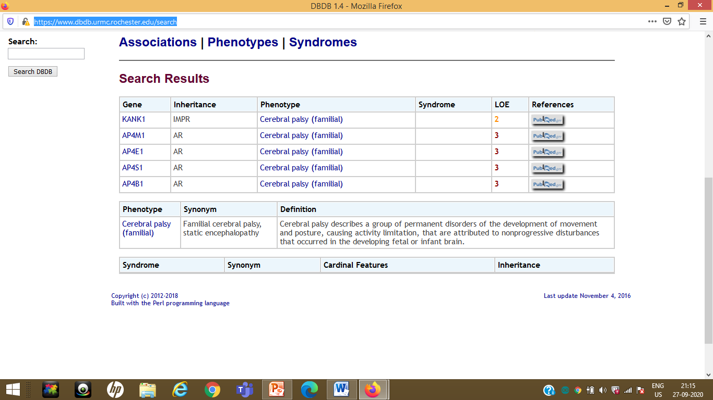
https://www.dbdb.urmc.rochester.edu/search

Slide 9
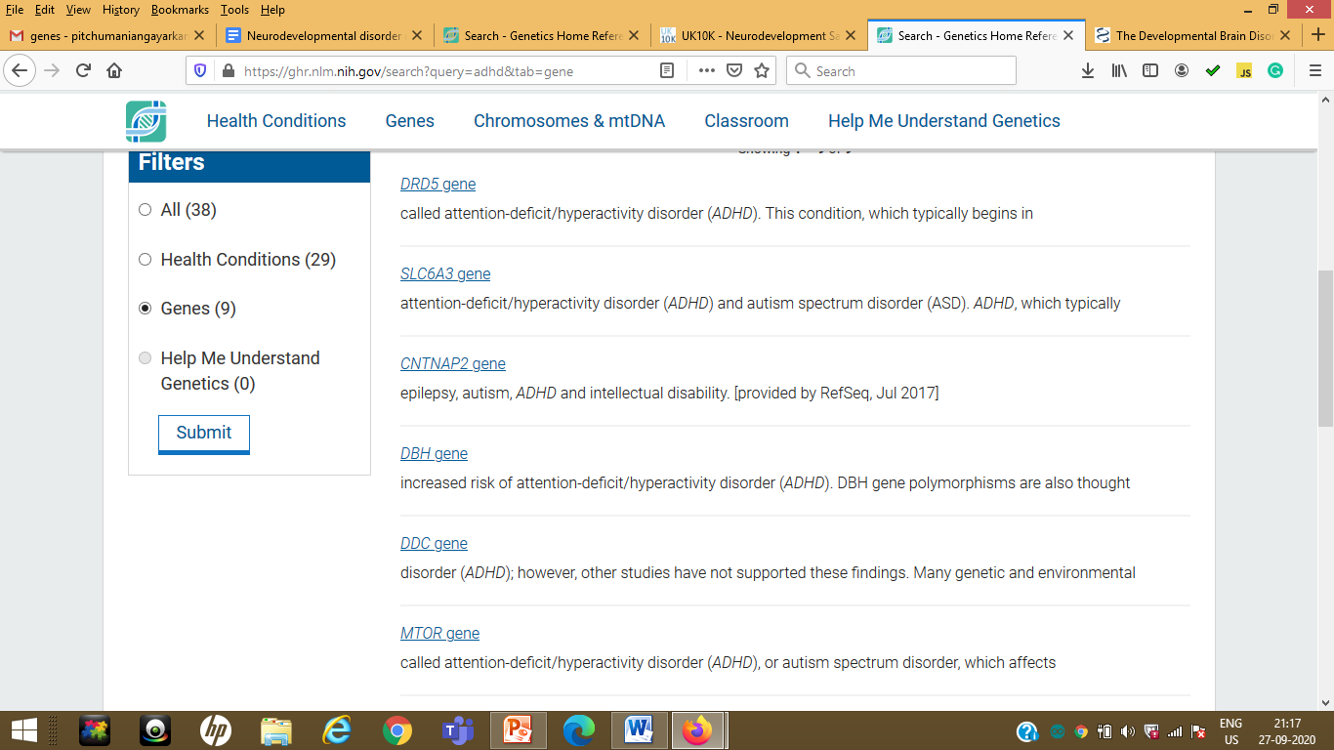

Slide 10
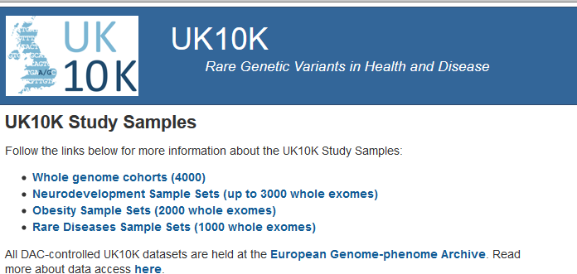
DataSet
Duchenne muscular dystrophy | https://www.dbdb.urmc.rochester.edu/associations/list | https://www.uk10k.org/studies/neurodevelopment.html
Cerebral palsy | https://www.dbdb.urmc.rochester.edu/associations/list
Autism | https://www.dbdb.urmc.rochester.edu/associations/list
ADHD | http://adhd.psych.ac.cn/

Slide 11
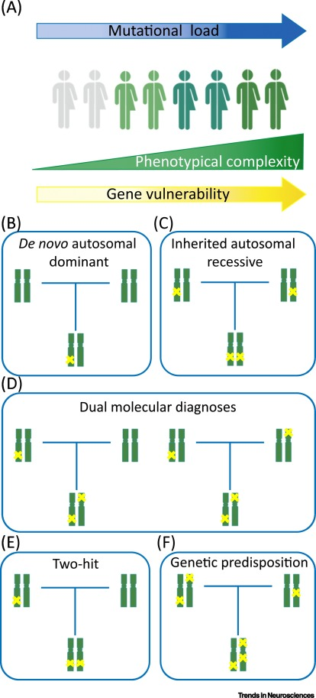
Schematic Representation of the Genetic Mechanisms of Neurodevelopment Disorders (NDDs).

Slide 12
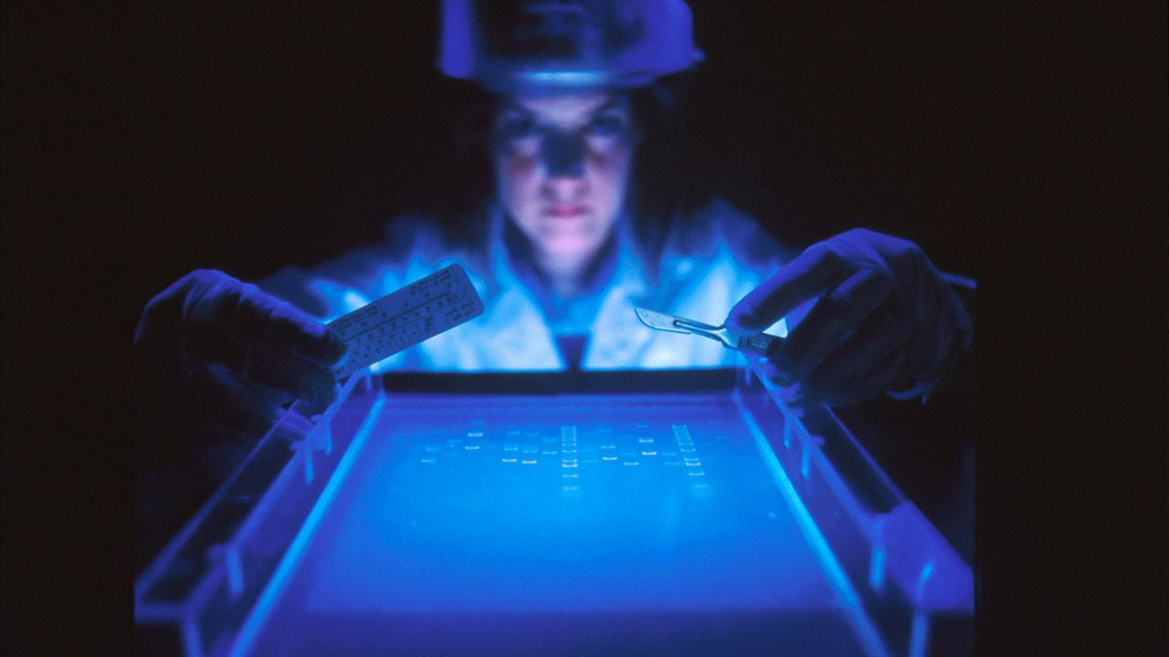
THANK YOU

